Slide 1


Slide 2

What is overriding?
The child class provides alternative implementation for parent class method.
The key benefit of overriding is the ability to define behavior that's specific to a particular subclass type.
Method overriding in C# is a feature like the virtual function in C++. Method overriding is a feature that allows you to invoke functions (that have the same signatures) that belong to different classes in the same hierarchy of inheritance using the base class reference.
C# makes use of two keywords: virtual and overrides to accomplish Method overriding.
Overridden method: In the superclass.
Overriding method: In the subclass.

Slide 3

using System;
class A
{
public virtual void Y()
{
// Used when C is referenced through A. Console.WriteLine("A.Y");
}
}

Slide 4

class B : A
{
public override void Y()
{
// Used when B is referenced through A. Console.WriteLine("B.Y");
}
}
class C : A
{
public void Y()
// Can be "new public void Y()"

Slide 5
{
// Not used when C is referenced through A. Console.WriteLine("C.Y");
}
}
class Program
{
static void Main()
{
// Reference B through A.

Slide 6
A ab = new B();
ab.Y();
}
}
Result
B.Y

Slide 7

The overriding method CAN throw any unchecked (runtime) exception, regardless of whether the overridden method declares the exception.
An unchecked exception, also called runtime exception, is detected only at runtime.
Examples of unchecked exceptions:
ArithmeticException
ArrayIndexOutOfBoundsException
NullPointerException
NumberFormatException

Slide 8
The overriding method must NOT throw checked exceptions that are new or broader than those declared by the overridden method.
A checked exception is an exception that is checked at compile time. The compiler will complain if a checked exception is not handled appropriately.
Examples of checked exceptions:
IOException
  FileNotFoundException
  EOFException

Slide 9
An overriding method doesn't have to declare any exceptions that it will never throw, regardless of what the overridden method declares.
You cannot override a method marked final.
You cannot override a method marked static.

Slide 10
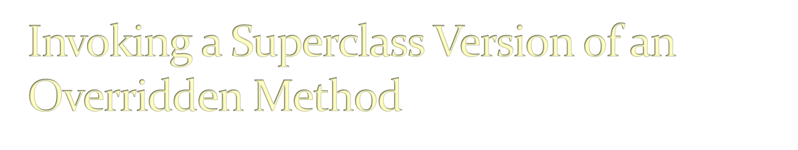
Use the code in the overridden method.
Also add extra features in overriding method.

Slide 11


Slide 12


